Slide 2
INTRODUCTION
a new approach to online advertising

Slide 3
SmartZones
The only cookie-free display advertising platform with 100% reach, verified data and enhanced privacy.

Slide 4
SmartZones
Solves the three challenges
of online advertising:

Slide 5
Solves the three challenges of online advertising:
Reach - Nearly 100% of qualified prospects every time

Slide 6
Solves the three challenges of online advertising:
2. Data Integrity - 90+ million demographic segments, defined by over 750 data variables

Slide 7
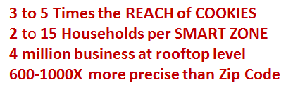
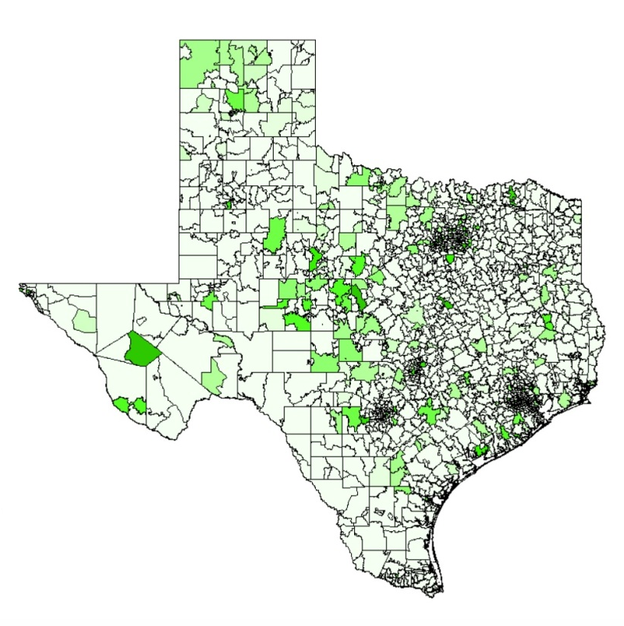
SMART ZONES REACH
29.8 Million SMART Zones in the US
  SZ identifies 1.8 billion IPs at the ISP delivery points for a neighborhood and for businesses at a rooftop level.
15.2 Million Homes Zones
14.7 Million Business Zones
5.3 Million Audio Zones
6.4 Million Premium Video Zones
798K School Zones
547K Government Zones
20+ Million – Users Scored for Zone-Based Retargeting
800+ Categories Scored for Contextual Retargeting
Media Quality Score + Bid Optimization
“SZ’s offers marketers the unique ability to target every
online audience based on real people who can afford your product.
SZ’s is guaranteed to reach 100% of the audience within a trade area..
Ideal for local retail store targeting, politics, travel, healthcare, hi-tech,
utilities, and especially finance.”

Slide 8
Solves the three challenges of online advertising:
3. Enhanced Privacy - Targeting without cookies and compliant with "Do Not Track”

Slide 9
Reach
Zero-sacrifice ad placement:
  A wide array of flexible ad formats allows you to engage with potential customers on every leading network exchange.
Notes:
Cookie-free and 100% reach does not mean you must sacrifice where your ads run.

Slide 10
Mailbox to Modem
Scoring Engine drives over 1200 predictive models and scoring in real time.

Slide 11
ENHANCED PRIVACY

Slide 12
Targeting without Cookies
Billions of digital advertising in the U.S. is dependent on using third-party cookies to locate and target relevant consumers.
Notes:
$20 billion of digital advertising in the U.S. is dependent on using third-party cookies to locate and target relevant consumers. Smart Zones eliminates this dependency. Smart Zones will target relevant consumers with your ads without dropping cookies. This meets the trending privacy demands on the ad-tech industry.
Rather than depending on third-party cookies, Smart Zones defines your targeted audiences with enhanced data integrity – 1200 demographic, Firmographic, purchase and lifestyle attributes. Smart Zone has over 25 million high-integrity audiences defined.

Slide 13
Targeting without Cookies
Do Not Track legislation aimed at third parties is ongoing.
Display advertisers must find a way to target relevant audiences without relying on third-party cookies.

Slide 14
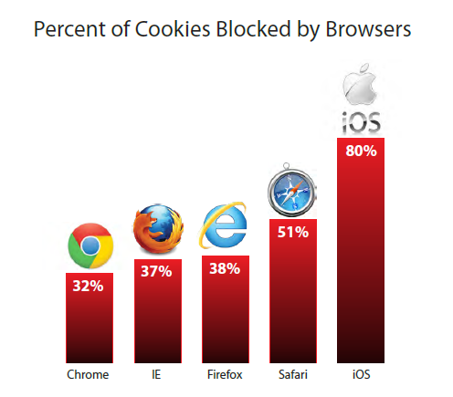
Targeting without Cookies
The number of unique users reachable by cookie-based targeting for national campaigns averages 30 to 35%, and is dropping rapidly.
Notes:
$20 billion of digital advertising in the U.S. is dependent on using third-party cookies to locate and target relevant consumers. Smart Zones eliminates this dependency. Smart Zones will target relevant consumers with your ads without dropping cookies. This meets the trending privacy demands on the ad-tech industry.
Rather than depending on third-party cookies, Smart Zones defines your targeted audiences with enhanced data integrity – 1200 demographic, Firmographic, purchase and lifestyle attributes. Smart Zone has over 25 million high-integrity audiences defined.

Slide 15
Targeting without Cookies
Rather than depending on third-party cookies, SmartZones defines your targeted audiences with enhanced data integrity.
Notes:
$20 billion of digital advertising in the U.S. is dependent on using third-party cookies to locate and target relevant consumers. Smart Zones eliminates this dependency. Smart Zones will target relevant consumers with your ads without dropping cookies. This meets the trending privacy demands on the ad-tech industry.
Rather than depending on third-party cookies, Smart Zones defines your targeted audiences with enhanced data integrity – 1200 demographic, Firmographic, purchase and lifestyle attributes. Smart Zone has over 25 million high-integrity audiences defined.

Slide 16
Targeting without Cookies
SmartZones has 1,200 demographic, Firmographic, purchase and lifestyle attributes.
Notes:
$20 billion of digital advertising in the U.S. is dependent on using third-party cookies to locate and target relevant consumers. Smart Zones eliminates this dependency. Smart Zones will target relevant consumers with your ads without dropping cookies. This meets the trending privacy demands on the ad-tech industry.
Rather than depending on third-party cookies, Smart Zones defines your targeted audiences with enhanced data integrity – 1200 demographic, Firmographic, purchase and lifestyle attributes. Smart Zone has over 25 million high-integrity audiences defined.

Slide 17
Targeting without Cookies
Smart Zones is the only cookie-free solution and is backed by proven performance metrics.

Slide 18
THE PAYOFF

Slide 19
Proven Performance Metrics
Proof is in the Numbers:
  100% Reach
  0 Cookies
  110% to 550% Performance Lift

Slide 20
The Data Difference
Closing the loop with
Multi-Channel Marketing:
Offline Data
CRM Enhancement
Device Independent Online Data
Offline & Online BI & Audience Optimization
Providing a common data link between the CMO office -> BI -> Agency -> Ad-Tech:
Smart Zones provides Universal Data Linkage
Automated Analytics with RT-Decision Making
Marketing Appliance: Business Intelligence & Audience Building
Automated Predictive Modeling
Smart Zones
Marketing Appliance
Data

Slide 21

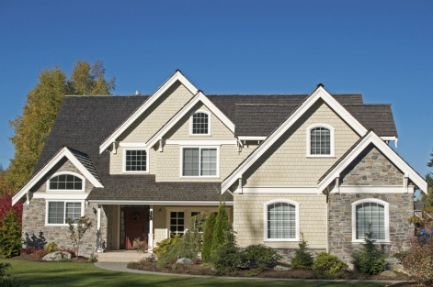



Data Sources
All data is based on publicly available information, adhering the the highest standards of Privacy and FTC Recommendations – both online or offline.
A primary data creator & supplier to Acxiom, V12, as well as over 100 major consumer accounts: Southwest, United, Hilton, Hyatt, Wynn, Time Warner, Lowes, EBay, etc.
We compile, create, package and own all the data – no royalties
Bureau of Economic Analysis, IRS, FR
Income & discretionary income estimates
Federal Reserve, FHA, FHFA
Home pricing & transaction history
Auto Ownership
Dealer & repair organizations
Voter Registration
Party Affiliation &
Contribution History
Consumer Propensity
Product of predictive models & third party data

Slide 22

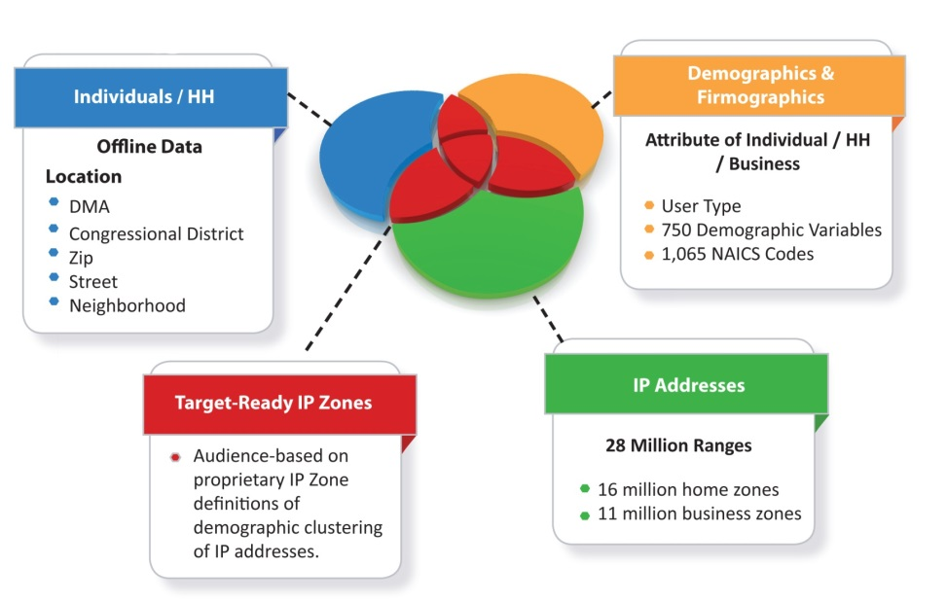


SMART ZONES: Cookie-Free Audience Targeting
Mapping the Consumer, Business and Media using patented genetic algorithms and predictive clustering technology.
100% REACH: With no cookies every qualified prospect who is online is now available for targeting. Device Independent.
RICH AUDIENCE DATA: Based on verified demographics - Multivariate data & models identify prospects. No more “thin data”, inferred intent, or single purchase decisions.
CONTEXTUAL RELEVANCE: programmatic mapping of audiences to media
based on history billions of impressions and Real-Time in-line
learning process that executes auto-
segmentation, Category Retargeting
and Bid-Optimization.
PRIVACY: No cookies or tracking of
any kind. Do Not Track and Do Not
Collect compliant.

Slide 23
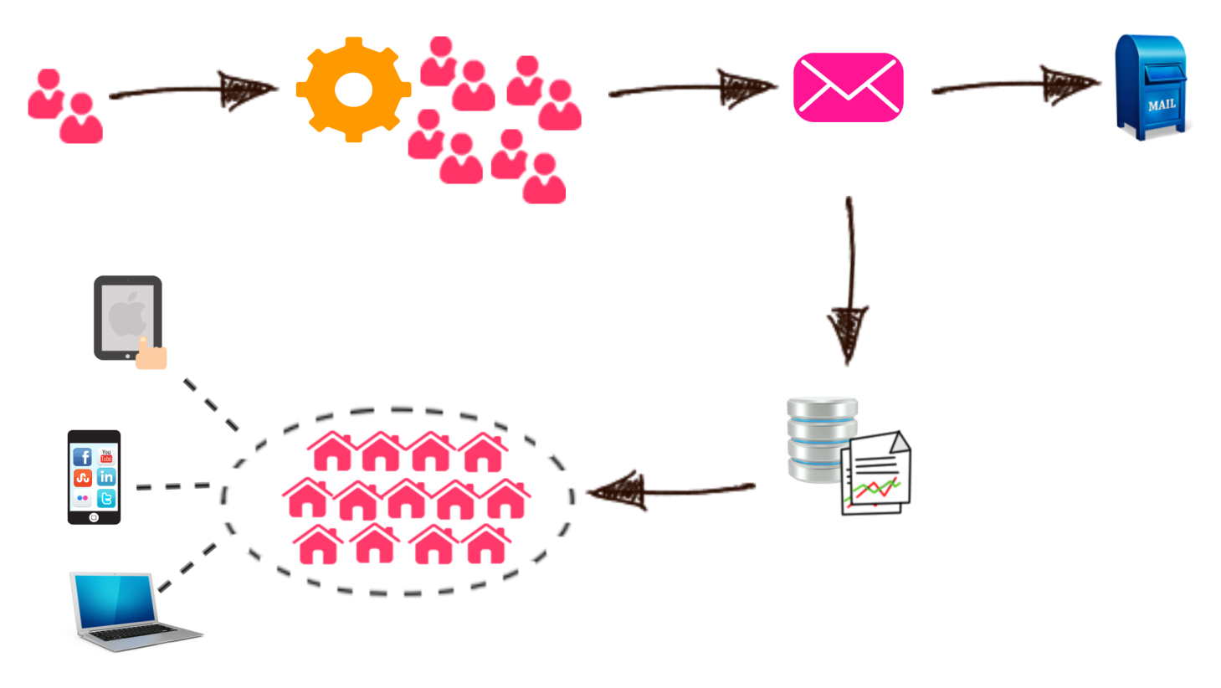
Smart Zone Campaigns: How We Do It
STEP 2:
We scan our offline database that covers 131 Mil households, and append over 750 demographic attributes to each record to initiate a predictive model.
STEP 1:
Upload your customer file either as an address or IP Address.
STEP 3:
A universe of look-alike prospects is scored and generated at an address and an IP Zone level. This list can be mailed to, or you can continue to step 4 for online targeting.
STEP 4:
Addresses are loaded into our Smart Zones platform which profiles the audience and converts it into anonymous Zones. Each Smart Zones represents a clusters of households that map based on demographic similarity and location.
Step 5:
The anonymous list of Zones is loaded into one of our partner DSPs or Trading Desk platforms for campaign execution. Since Smart Zones targets at the modem level, you reach your audience on multiple devices.

Slide 24
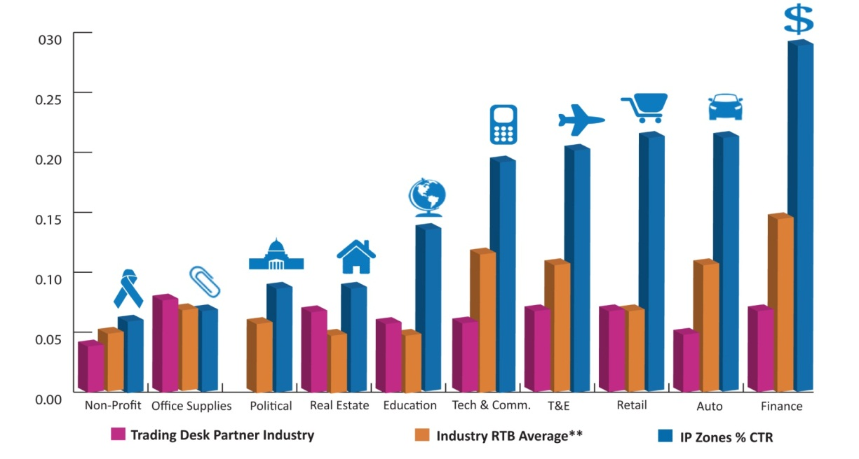
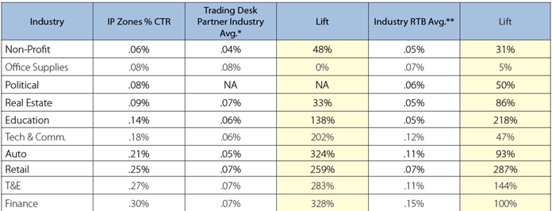
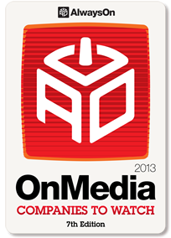
Smart Zones Performance
128% Lift

Slide 25


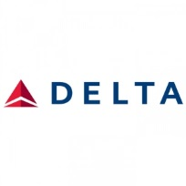

































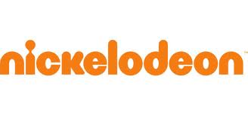



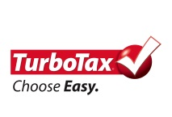


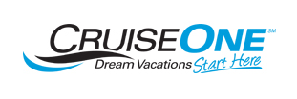







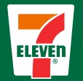






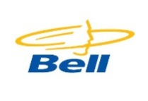



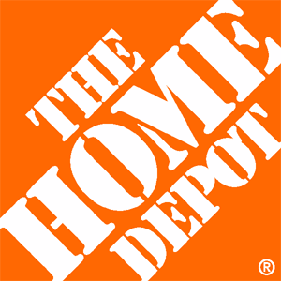













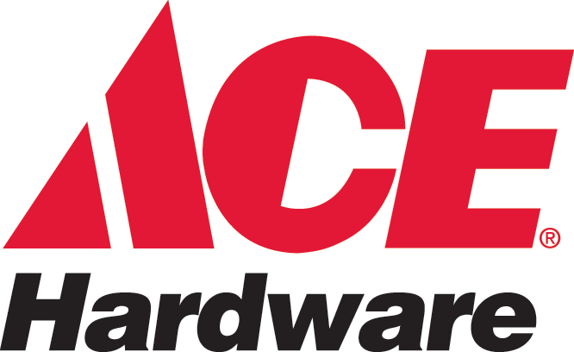



Campaign Tested
Auto
Financal Services
Retail
T&E
Advocacy
Communication
Education

Slide 26
let’s get started
SmartZonesbyJD.com
Notes:
www.smartzonesbyjd.com
side bar items:
1. Complementary White Paper
Take a closer look at the current issues around cookies and how the new Smart Zones approach is successfully targeting more online audiences.
REQUEST IT <link to contact form, then Rob will send qualified prospects the white paper as a PDF (Kevin is creating a JD/SZ version of the white paper Semcasting created)>
2. Free Audience Report
See what Smart Zones has to offer your digital advertising initiatives with a free look at your audiences' profile.
REQUEST IT <link to contact form, then Rob will contact>
3. Request a Smart Zones Demo
A 30-minute webcall is all it will take to demonstrate the powerful effect Smart Zones on your digital advertising.
REQUEST IT <link to contact form, then Rob will contact>

